Slide 1

SMS Spam Detection
Team 11:
D22014 – Chothani Jay Rameshbhai
D22017 – Gowtham Kumar
D22018 – Himanshu Yadav

Slide 2
Data Pre-processing flow diagram
Drop Duplicates
Lemmatization
Removing Stop Words
Converting into Lower Cases
Removing Punctuations
Dropping the Duplicates from the data
Converting the text into lower cases
Removing stop words because stop words are common in all SMS and cannot help us in detecting spam texts
Removing punctuation from all SMS will help to treat each text equally
Lemmatization is a process in Natural Language Processing that converts a word to its base form or root word

Slide 3
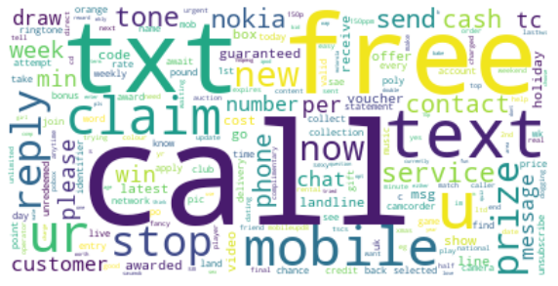
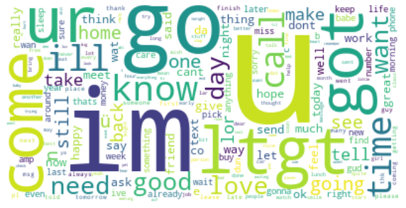
Word Clouds
Word cloud for spam SMS
Word cloud for not spam SMS
As per the word cloud of spam and not spam we can see different words repeating in both images.
In the word cloud of spam we can see the words like call, free, claim, txt, and reply these are repeated words.
In the word cloud of not spam we can see the words like im, go, come, know, got, and u these are the most repeated words.

Slide 4
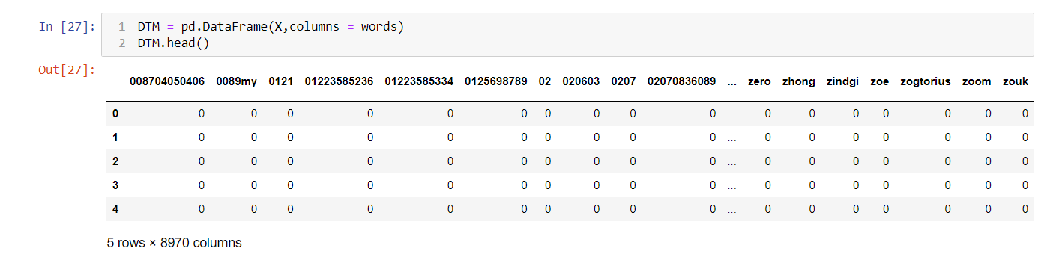
Vectorization Approaches
a) Vectorization using TF:
Vectorization using term frequency (TF) is a method of converting text data into numerical vectors for use in machine learning models. In this method, each document or text sample is represented as a vector of word frequencies, where each element in the vector corresponds to the number of occurrences of a specific word in the document. This representation is called a "term frequency" vector.
This is the DataFrame which we got after using TF for vectorization.

Slide 5
b) Vectorization using TF-IDF:
TF-IDF (term frequency-inverse document frequency) is a variation of this method that takes into account not only the frequency of a word in a document but also its rarity across the entire corpus of documents. This can help to down-weight common words (e.g. "the", "and", etc.) that appear frequently in many documents, and give more weight to words that are more specific to the document and less common across the entire corpus.

Slide 6
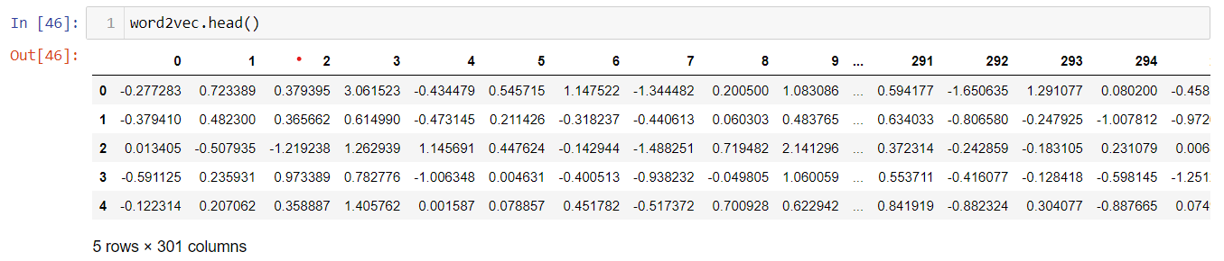
c) Doc-to-vec using Google’s word-to-vec Model:
Google's Word2Vec is a deep learning model that can generate dense vector representations (also known as word embeddings) of words in a given text corpus. These vector representations capture the semantic meaning of words and their relationships to other words in the corpus.
This above Dataframe using google’s word to vec model :
Each row represents the document and each column represents the element of the vector for the given document, word to vec gives the vector of length 300 so we have 301 columns out of that one for the label.

Slide 7
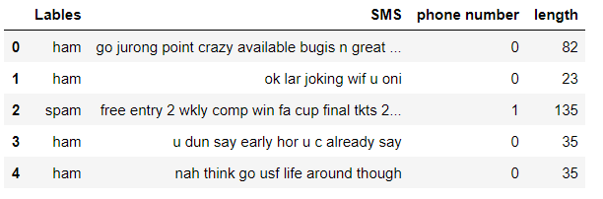
d) Heuristic Features
We have created two additional features phone number and length.
In phone number feature we are giving it 1 if phone number is presented in SMS otherwise it is zero
In length feature we are giving length of SMS

Slide 8
Dimension Reduction & Visualization
Principal Component Analysis (PCA) is a statistical technique that is used for dimensionality reduction and data visualization. It is a popular method for transforming high-dimensional data into a lower-dimensional space while preserving as much of the original information as possible.
As we have around 9000 columns so, we are using PCA to reduce the number of columns with 95% of the variance.

Slide 9
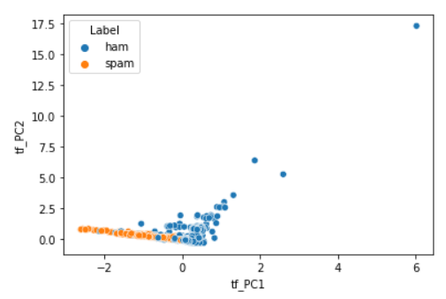
a) PCA on TF Dataframe:
We applied PCA on TF Dataframe with 95% of the variance and we got 2126 components.
Before PCA there were 8970 columns and after doing PCA it was reduced to 2126 columns.

Slide 10
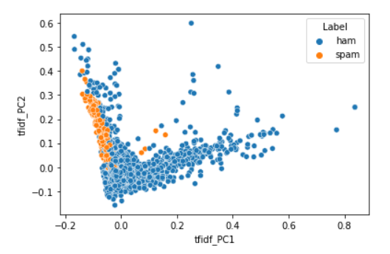
b) PCA on TF-IDF Dataframe:
We applied PCA on TF Dataframe with 95% of the variance and we got 2877 components.
Before PCA there were 8970 columns and after doing PCA it was reduced to 2877 columns.

Slide 11
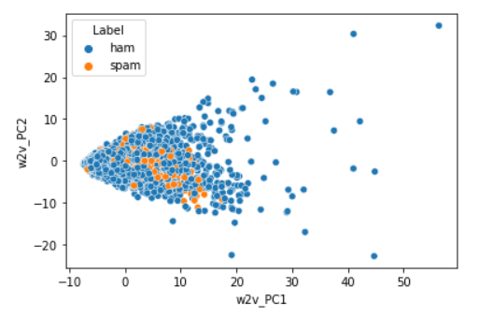
PCA for Word to vec:
We applied PCA for Word to vec data frame with 95% of the variance and we got 189 components.
Before PCA there were 300 columns and after doing PCA it was reduced to 189 columns.

Slide 12
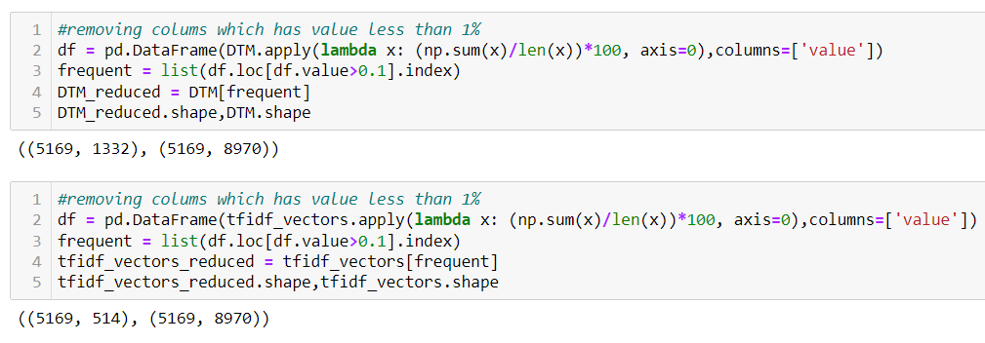
c) Heuristic Approach for Dimension Reduction:
In this, we have removed columns of word which is appearing in less than 1% of document
For TF Dataframe we are getting 1332 columns out of 8970 columns.
For TF-IDF Dataframe we are getting 514 columns out of 8970 columns.

Slide 13
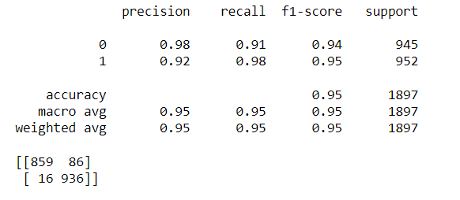
Competing Models
Models on TF Dataframe
1. Logistic Regression:
Aim: To predict the SMS is whether spam or not
Experiment: Applying Logistic Regression
Observations:
Conclusion:
f1-Score for zero is 94
f1-Score for one is 95

Slide 14
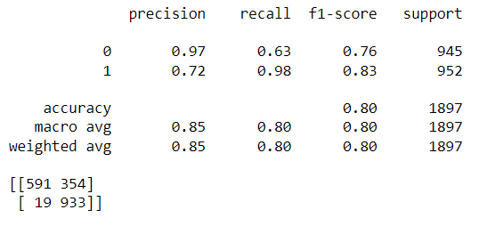
2. Decision Tree Classifier:
Aim: To predict the SMS is whether spam or not
Experiment: Applying Decision Tree Classifier
Observations:
Conclusion:
Here f1-score is decreasing compare to Logistic regression.

Slide 15
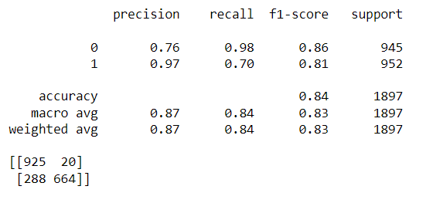
3.Random Forest Classifier:
Aim: To predict the SMS is whether spam or not
Experiment: Applying Random Forest Classifier
Observations:
Conclusion:
Here f1-score is less than logistic regression but greater than Decision Tree Classifier.

Slide 16
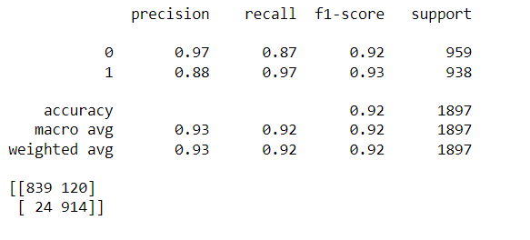
4.AdaBoost Forest Classifier:
Aim: To predict the SMS is whether spam or not
Experiment: Applying AdaBoost Forest Classifier
Observations:
Conclusion:
f1-Score for zero is 92
f1-Score for one is 93

Slide 17
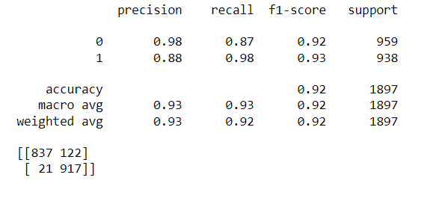
5.Bagging Classifier:
Aim: To predict the SMS is whether spam or not
Experiment: Applying Bagging Classifier
Observations:
Conclusion:
f1-Score for zero is 92
f1-Score for one is 93

Slide 18
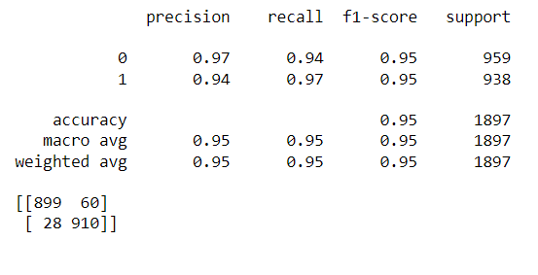
6.Support Vector Classifier(SVC):
Aim: To predict the SMS is whether spam or not
Experiment: Applying Support Vector Classifier
Observations:
Conclusion:
f1-Score for zero is 95
f1-Score for one is 95

Slide 19
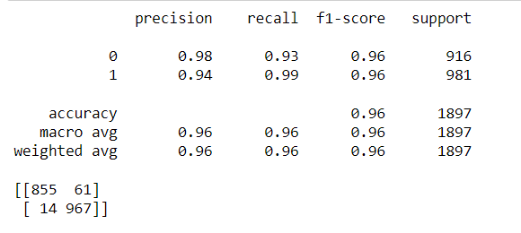
Models on TF-IDF Dataframe
7.Logistic Regression:
Aim: To predict the SMS is whether spam or not
Experiment: Applying Logistic Regression
Observations:
Conclusion:
f1-Score for zero is 96
f1-Score for one is 96

Slide 20
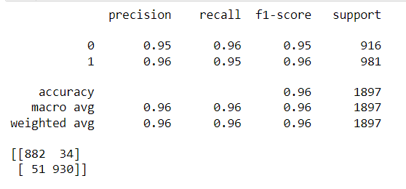
8.Decision Tree Classifier:
Aim: To predict the SMS is whether spam or not
Experiment: Applying Decision Tree Classifier
Observations:
Conclusion:
f1-Score for zero is 95
f1-Score for one is 96

Slide 21
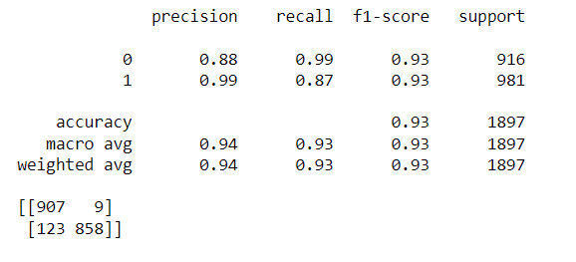
9.Random Forest Classifier:
Aim: To predict the SMS is whether spam or not
Experiment: Applying Random Forest Classifier
Observations:
Conclusion:
f1-Score for zero is 93
f1-Score for one is 93

Slide 22
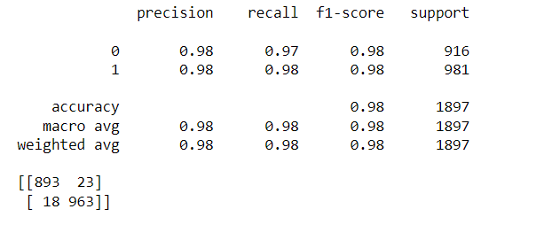
10.AdaBoost Classifier:
Aim: To predict the SMS is whether spam or not
Experiment: Applying AdaBoost Classifier
Observations:
Conclusion:
f1-Score for zero is 98
f1-Score for one is 98

Slide 23
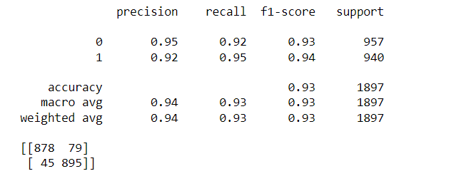
Models on Word 2 vec Dataframe
11.Decision Tree Classifier:
Aim: To predict the SMS is whether spam or not
Experiment: Applying Decision Tree Classifier
Observations:
Conclusion:
f1-Score for zero is 93
f1-Score for one is 94

Slide 24
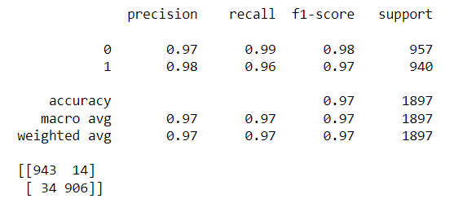
12.Support Vector Classifier(SVC):
Aim: To predict the SMS is whether spam or not
Experiment: Applying Support Vector Classifier
Observations:
Conclusion:
f1-Score for zero is 98
f1-Score for one is 97

Slide 25
Conclusion:
For TF vectorized data we are getting the highest F1 score for both classes 0.95 with SVC and LogisticRegression.
For TF-IDF vectorized data we are getting the highest f1 score of 0.98 with SVC.
For word 2 vec all models are giving f1 score of more than 0.93.
As per our experiment we can see that SVC is giving us very good results for all types of data.
Word 2 vec model is giving good results with all models compared to other vectorized data.

